Slide 1

Some “Hard” Talk
In the GPU era
May 15, 2024

Slide 2
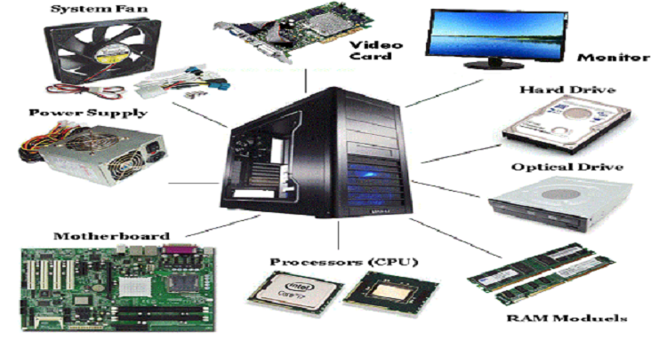
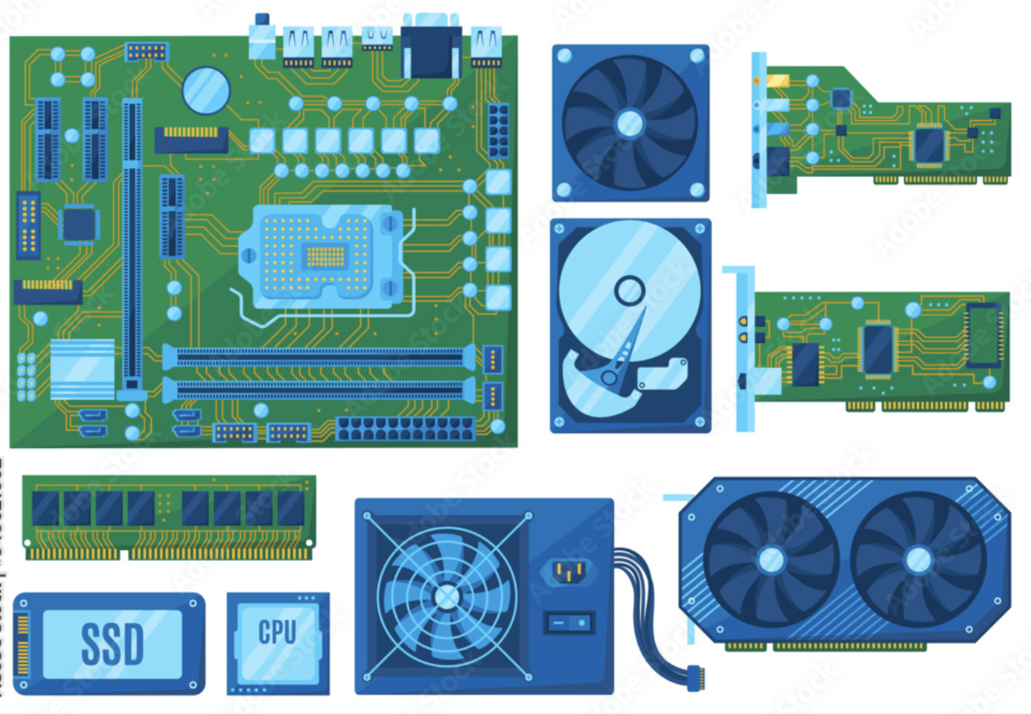
Computing System: Processor – RAM -- Disk

Slide 3
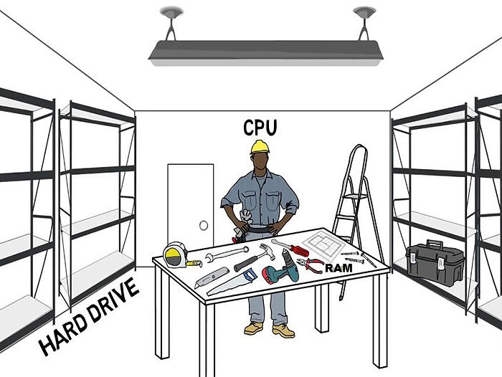
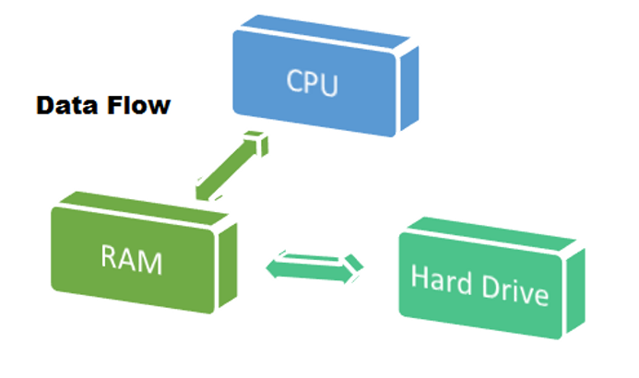
Volatile
Fast
Size Limited
Permanent
Not as fast
Size can be big

Slide 4
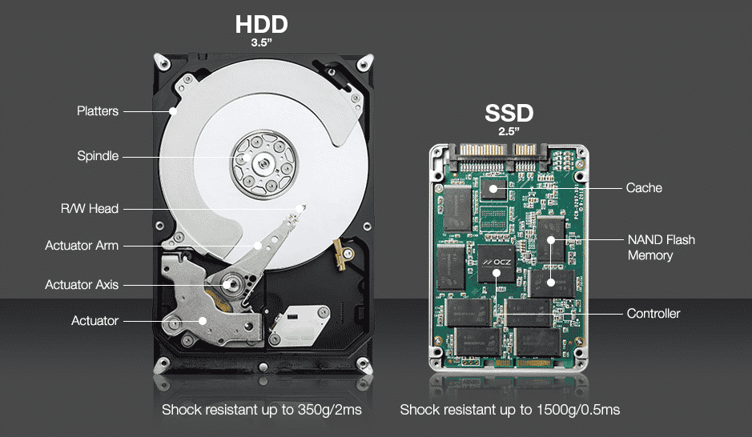
Disk
when moving large files, (in 2024)
HDDs: copy 30 to 150 MB per second (MB/s), while standard SATA SSDs can copy at speeds of 500 MB/s.
Newer NVMe SSDs can reach speeds of 3,000 to 3,500 MB/s
top-performing NVMe drives can reach speeds of up to 9,000 MB/s ~ 12, 000 MB/s
 | Cost | Speed | Durability | Highest capacity | Energy efficiency
HDD | Cheaper | Slower | Less durable | 10 TB | Use more energy
SSD | More expensive | Faster | More durable | 4 TB | Use less energy
from HDD to SSD

Slide 5
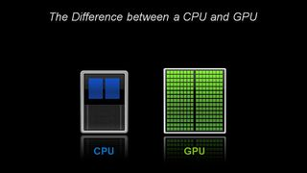
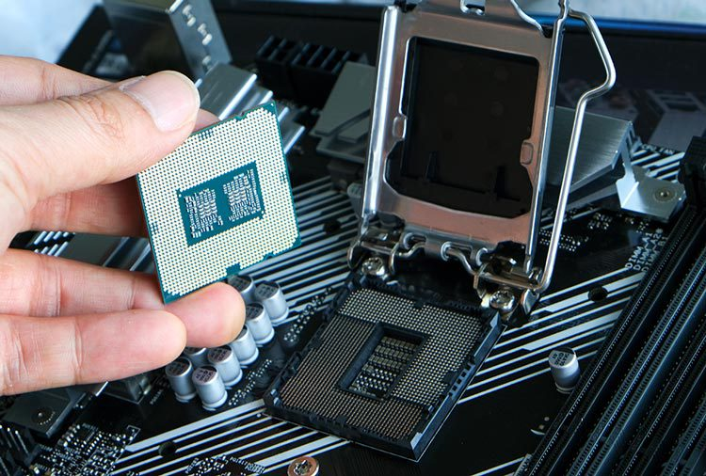
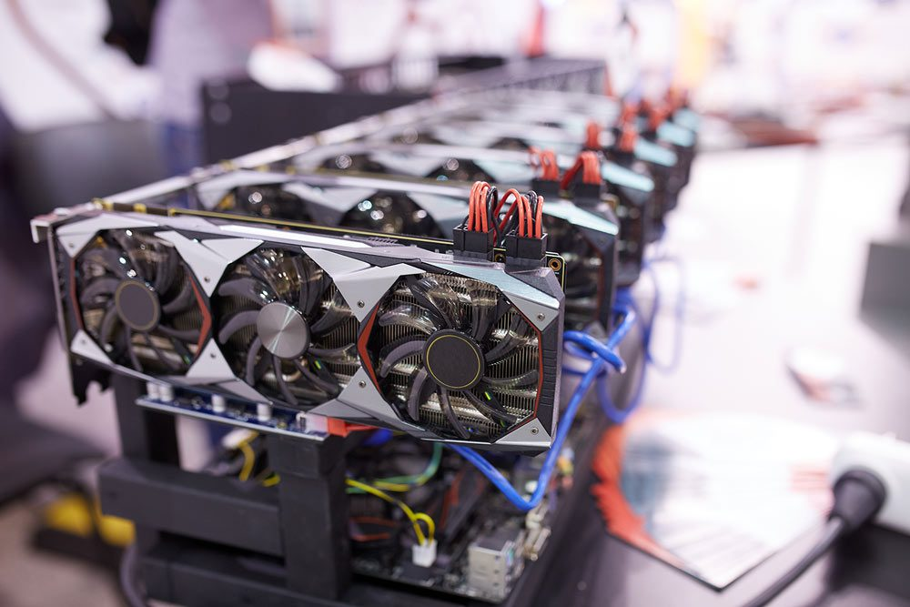
Processor

Slide 6
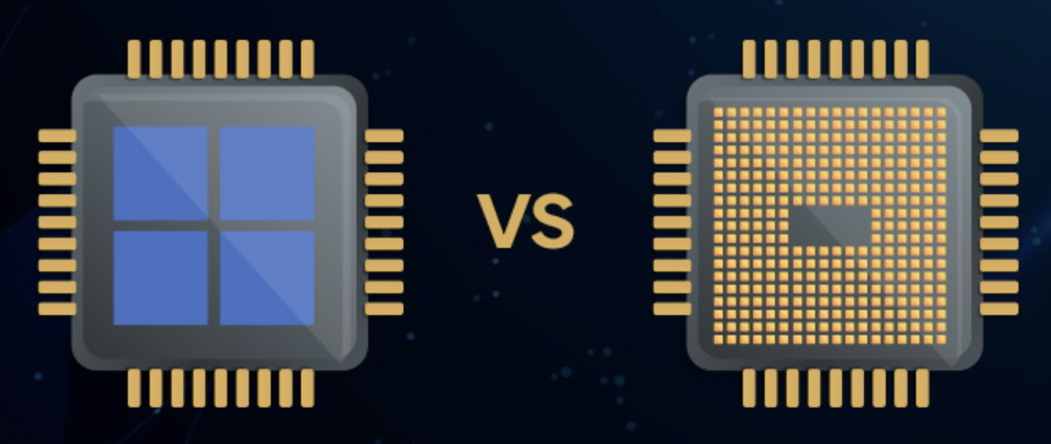
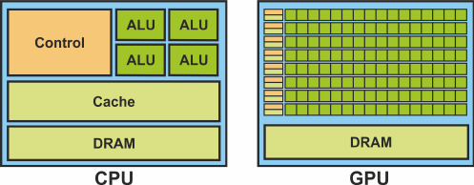
ALU: Arithmatic Logic Unit
DRAM: Dynamic Random Acess Memory
Cache: SRAM, faster, smaller

Slide 7
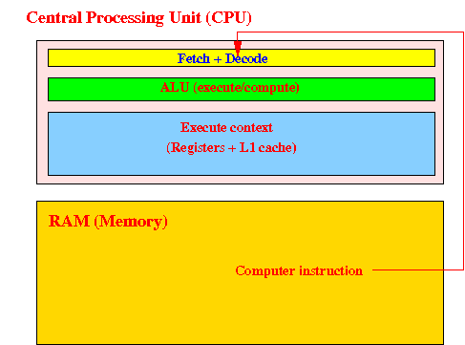
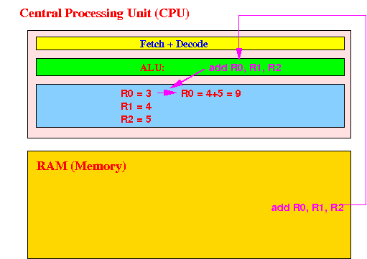
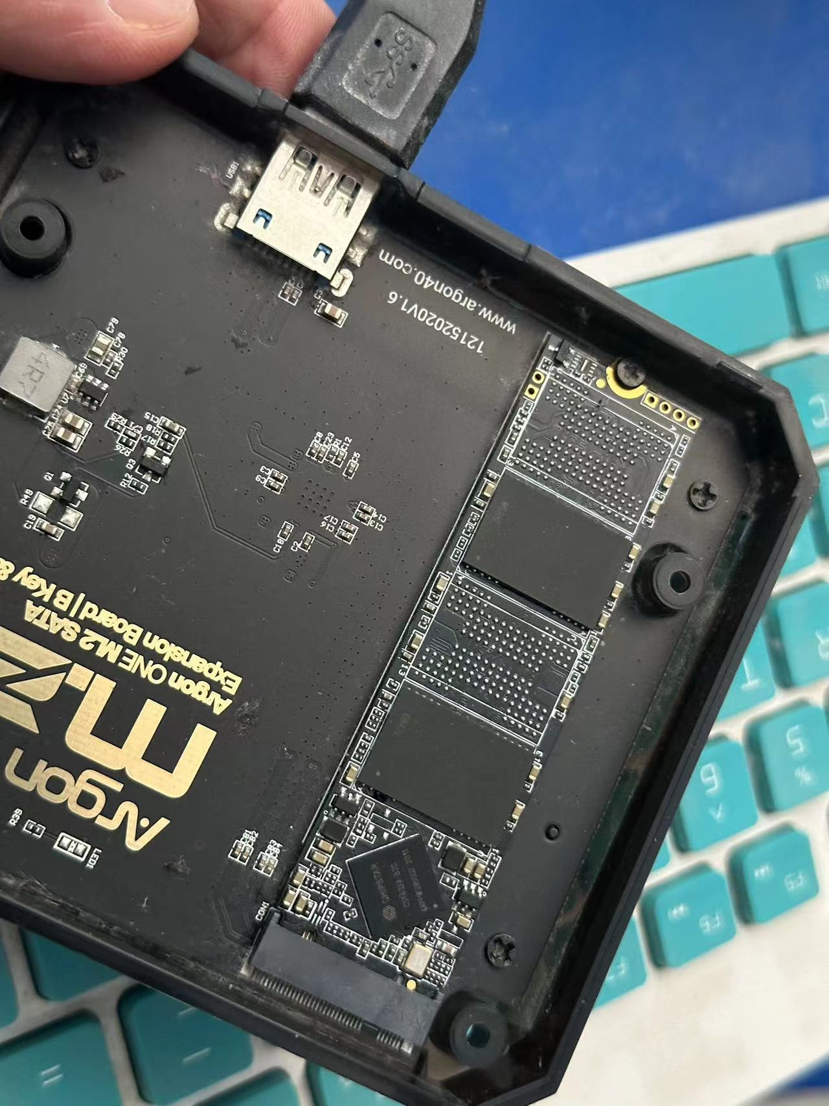
CPU: SISD – Single Instruction Single Data

Slide 8
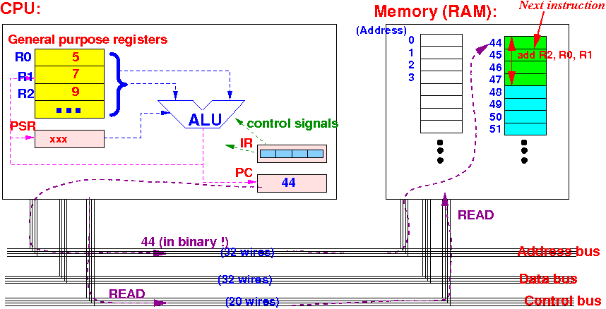
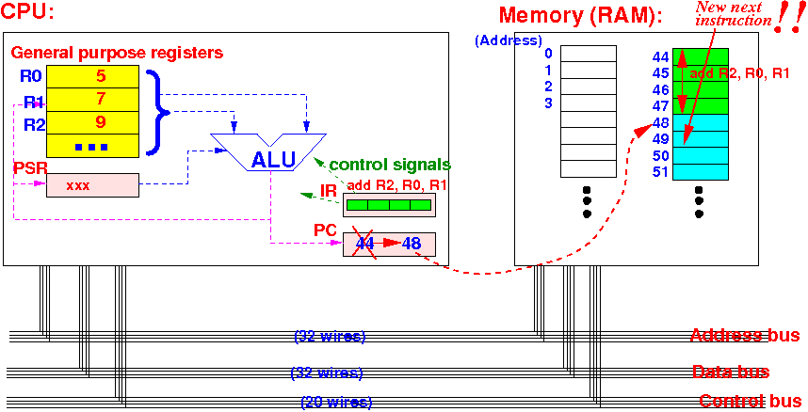
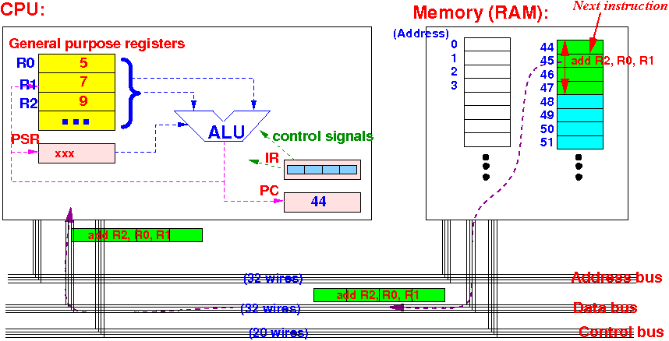
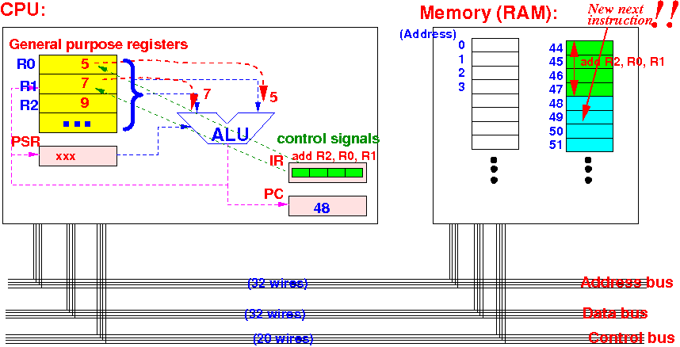
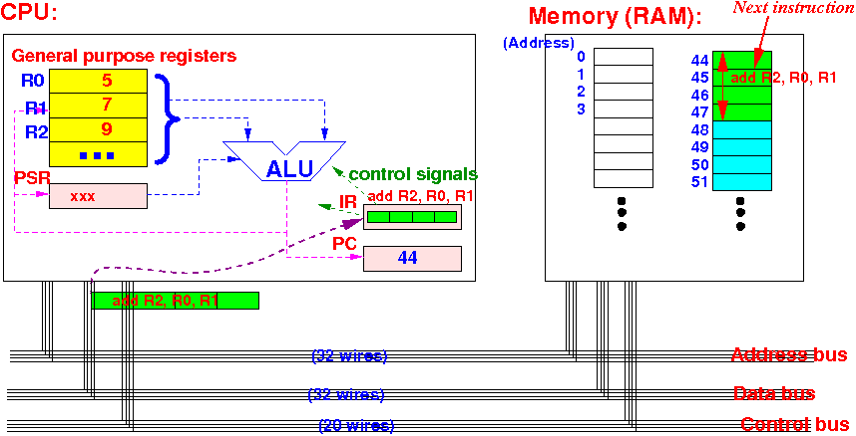
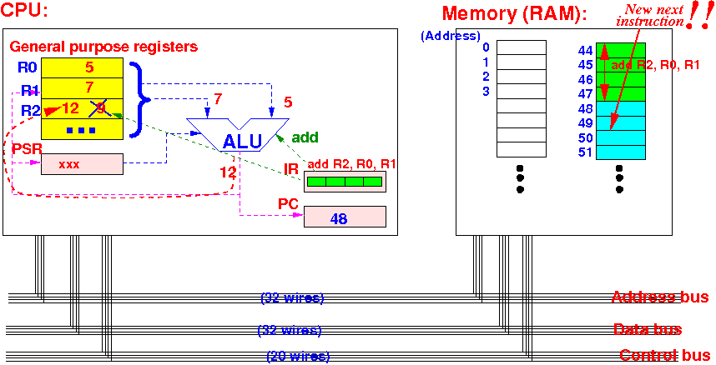
1
4
2
5
3
6

Slide 9
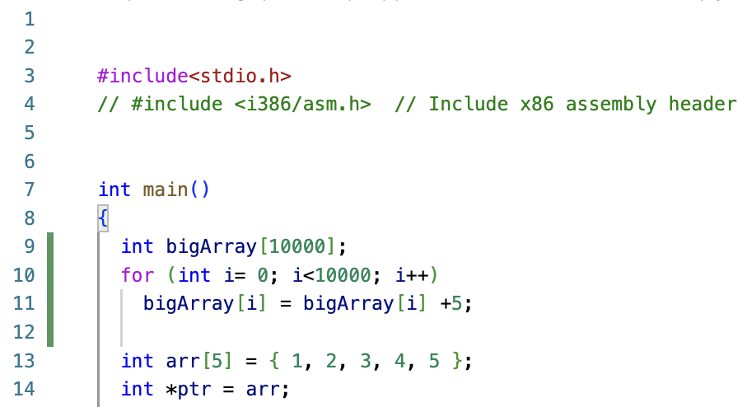
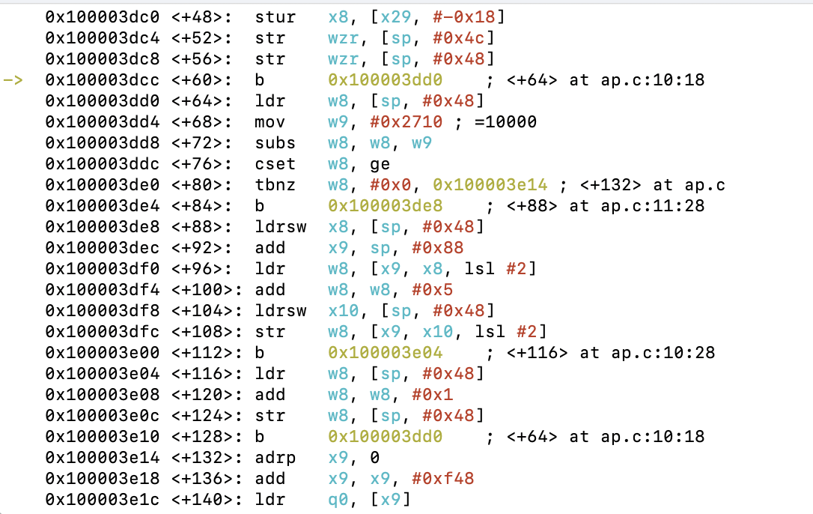
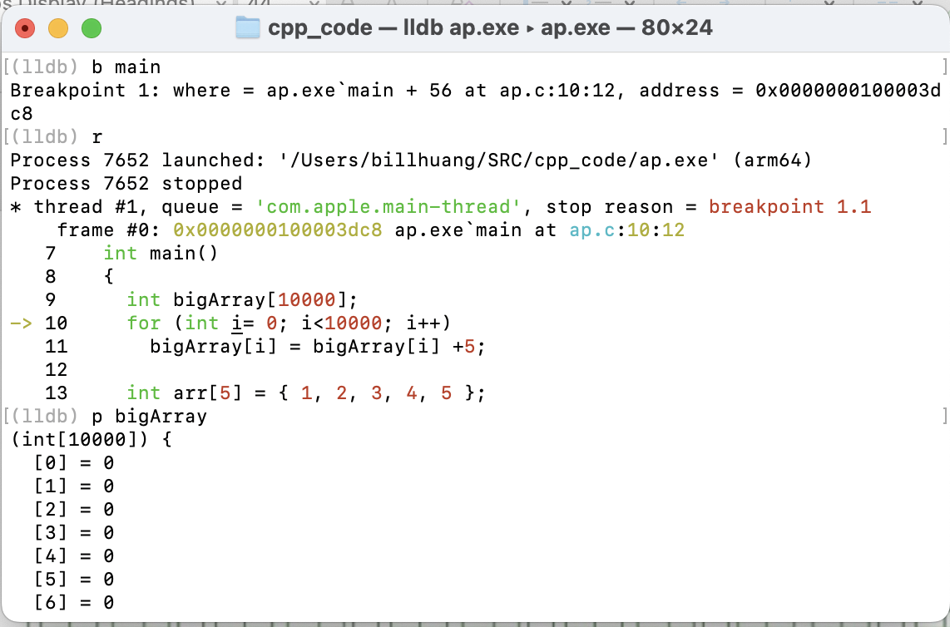

Slide 10
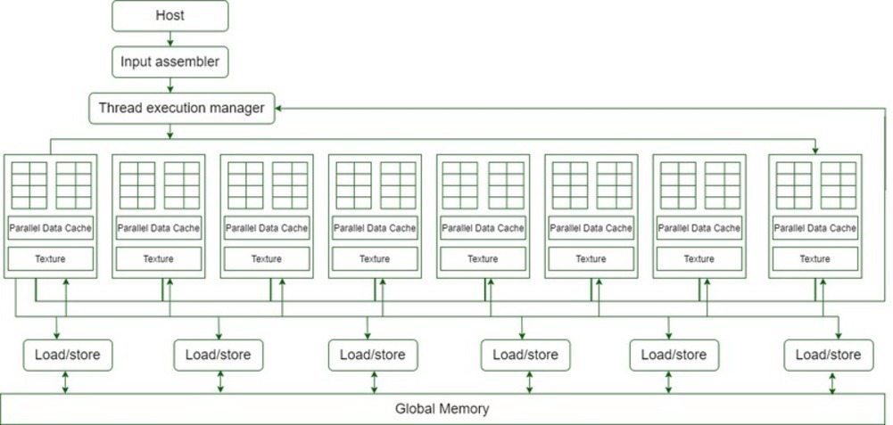
GPU: SIMD – Single Instruction Multi Data

Slide 11
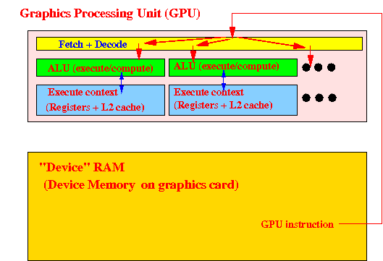
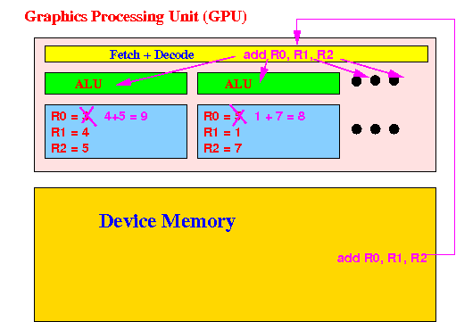

Slide 12
#include <cuda.h>
#include <cuda_runtime.h>
__global__ void incrementArray(int* data, int size) {
int i = blockIdx.x * blockDim.x + threadIdx.x;
if (i < size) {
data[i] += 5;
}
}
int main() {
// Allocate memory on the host (CPU)
int *hostArray = new int[10000];
// Initialize the array on the host
for (int i = 0; i < 10000; i++) {
hostArray[i] = 0; // Assuming you want to initialize with 0
}
// Allocate memory on the device (GPU)
int *deviceArray;
cudaMalloc(&deviceArray, 10000 * sizeof(int));
// Copy data from host to device
cudaMemcpy(deviceArray, hostArray, 10000 * sizeof(int), cudaMemcpyHostToDevice);
// Define the number of threads and blocks for the kernel
int threadsPerBlock = 256;
int blocksPerGrid = (10000 + threadsPerBlock - 1) / threadsPerBlock;
// Launch the kernel on the GPU
incrementArray<<<blocksPerGrid, threadsPerBlock>>>(deviceArray, 10000);
// Synchronize to ensure kernel execution is complete
cudaDeviceSynchronize();
// Copy data back from device to host (optional, for verification)
cudaMemcpy(hostArray, deviceArray, 10000 * sizeof(int), cudaMemcpyDeviceToHost);
// Free memory on the device
cudaFree(deviceArray);
// Free memory on the host
delete[] hostArray;
return 0;
}
~ 40 thread blocks, each has 256 threads

Slide 13
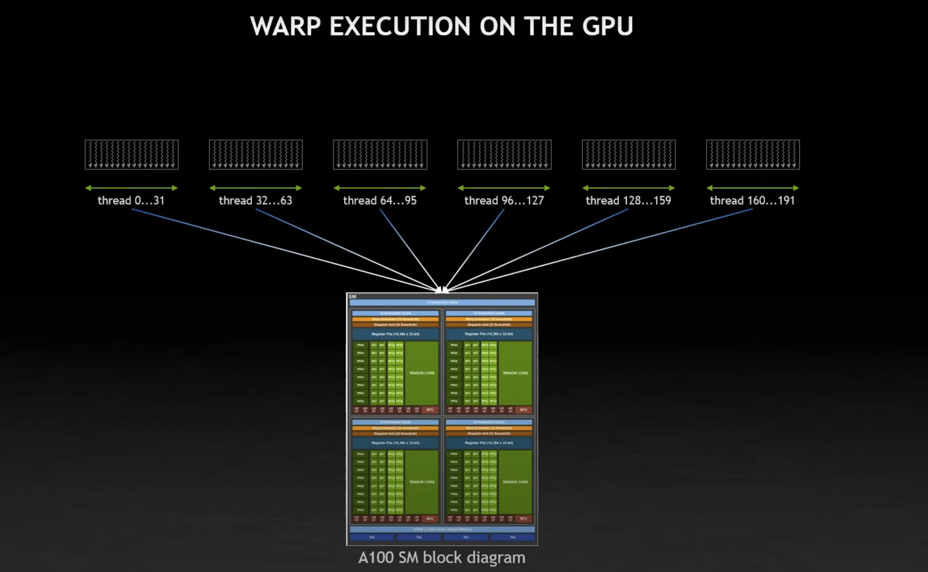
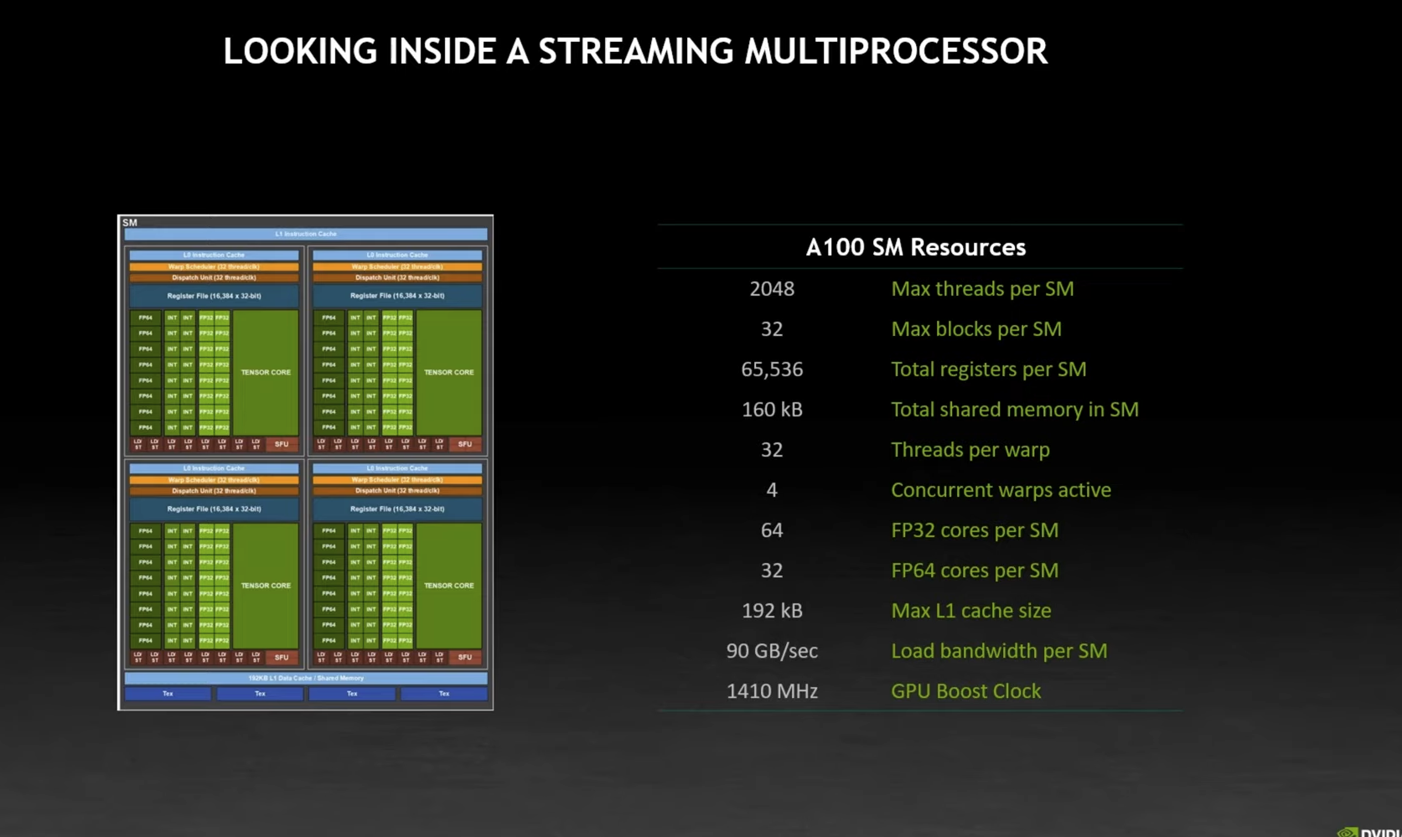
GPU thread scheduling
warp: 32 threads
SM: Streaming Multi-processor, each SM can queue 32 warps, processing 4 warps concurrently.
GPU Type | A100 | H100 | H200 | B100 | B200 | GB200
# of SMs | 108 | 132 | ~132 | 144 | 160 | 160 x 2?
1. 40 Thread Blocks x 256 threads in the code last slide
2. 32 threads per warp
3. 40 x 256 / 32 = 320 warps
4. Max 32 warps per SM on A100, with active size 4
5. 10-80 SMs, depending on availability of SMs
Fast!

Slide 14
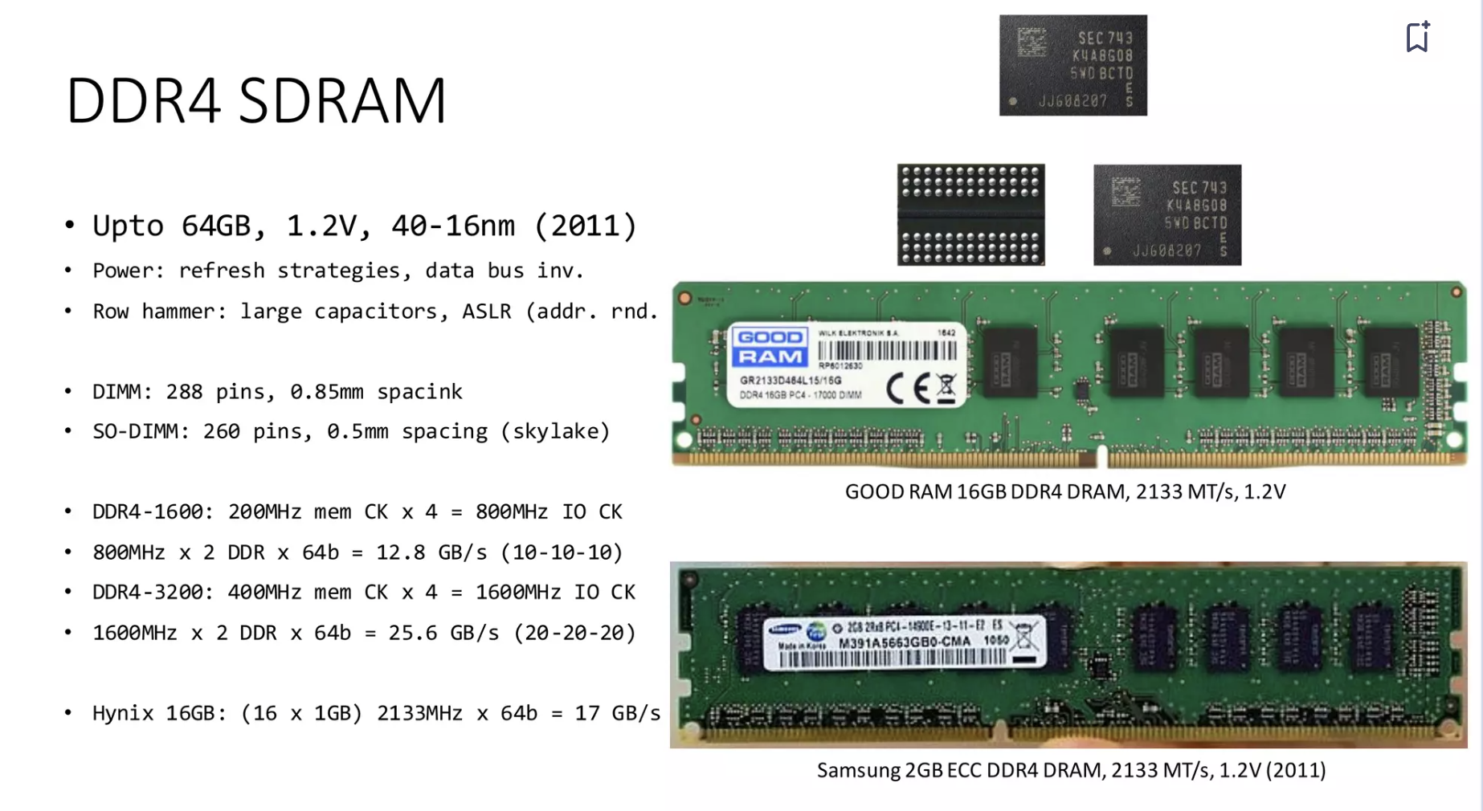
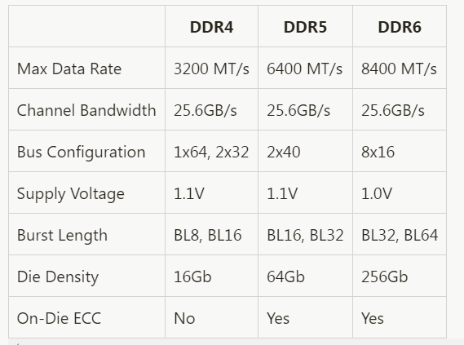
RAM
DDR: DDR stands for Double Data Rate. This is the most common type of memory found in personal computers (PCs).
SDRAM: Synchronous Dynamic Random-Access Memory, synchronizes its operations with the system clock for coordinated data transfer.

Slide 15
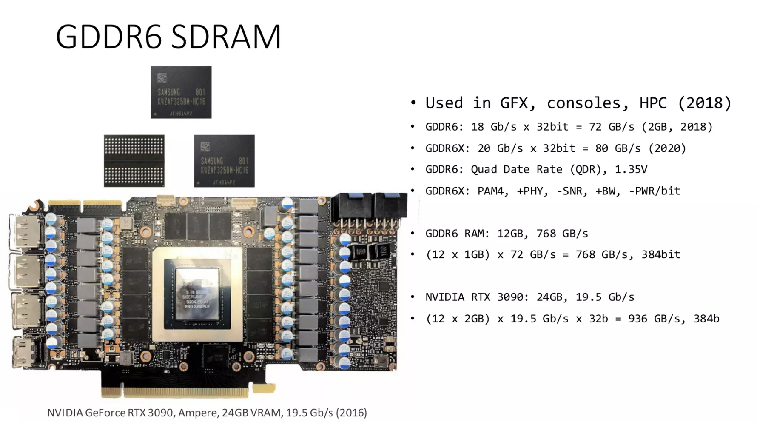
GDDR: GDDR stands for Graphics Double Data Rate. As the name implies, it's a specialized type of DDR memory designed for graphics cards (GPUs).

Slide 16
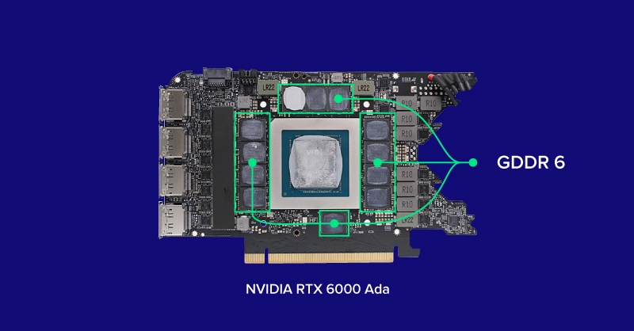
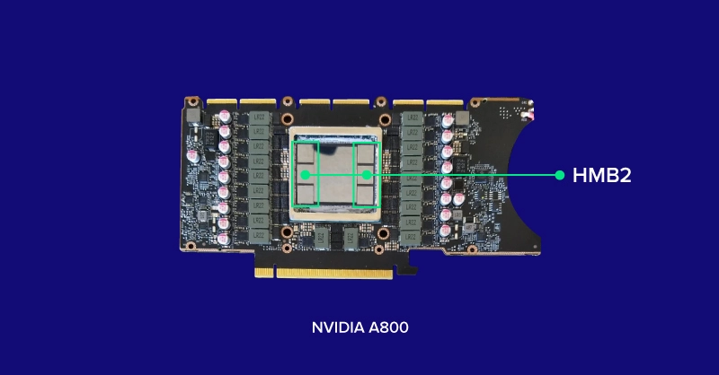
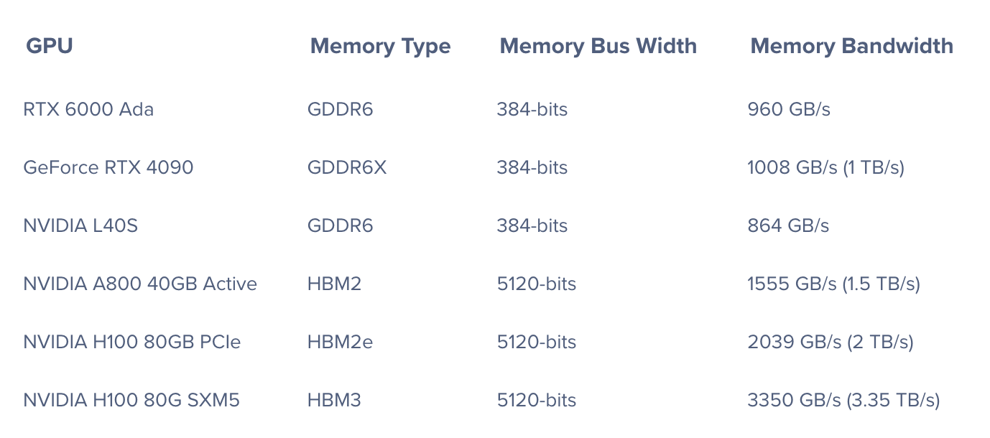
HBM: HBM stands for High Bandwidth Memory, typically used in high-performance applications like supercomputers and high-end graphics cards where data speed is crucial.

Slide 17
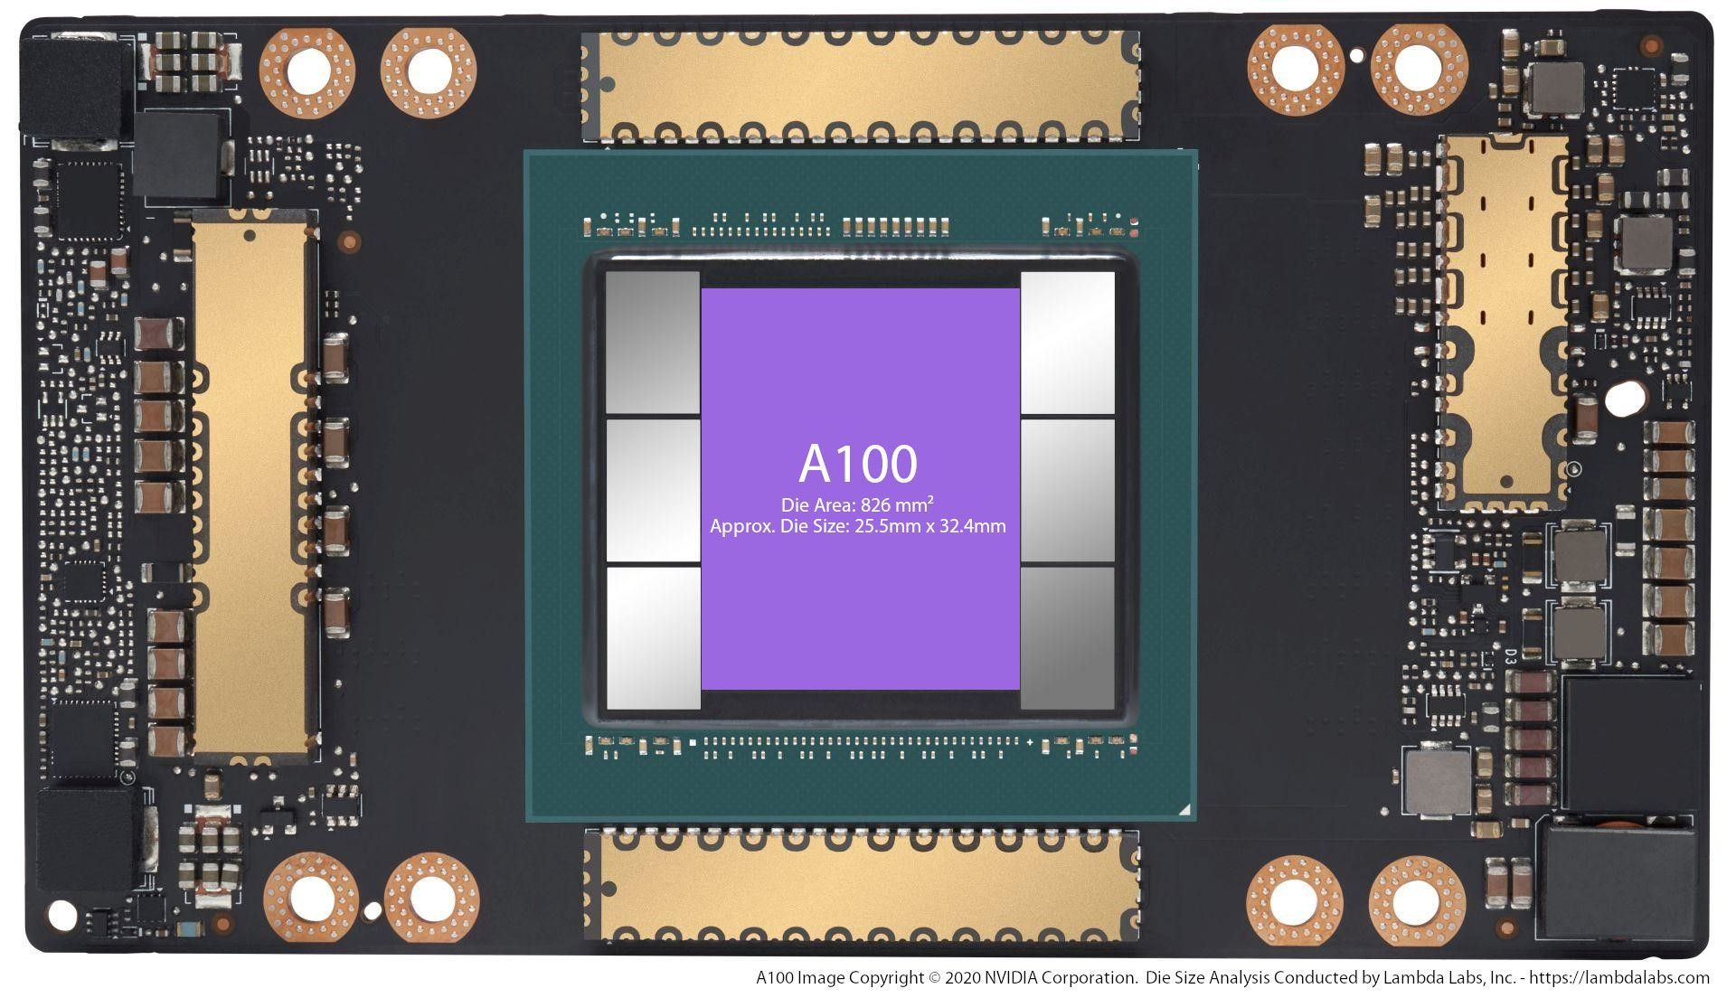
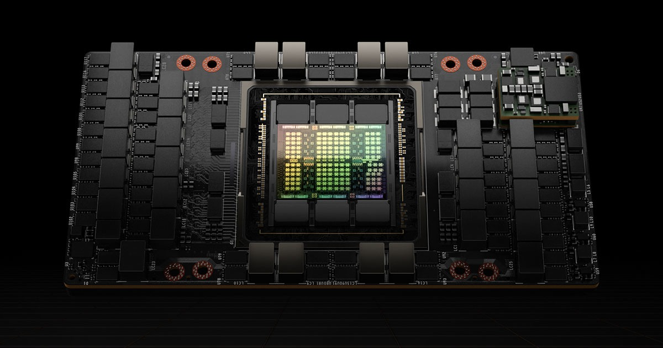
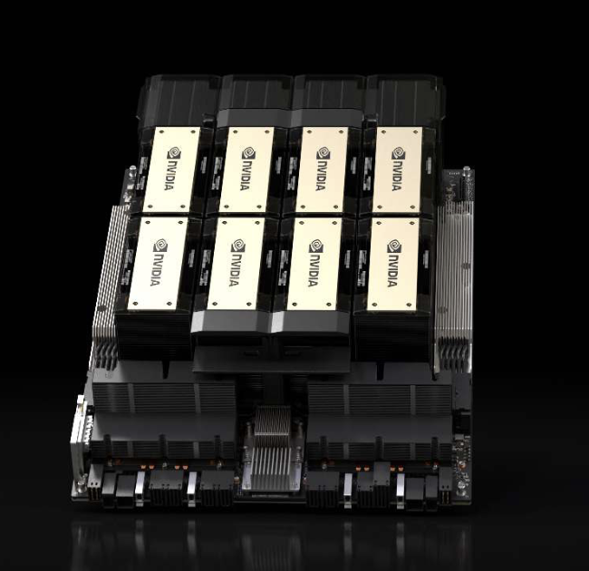
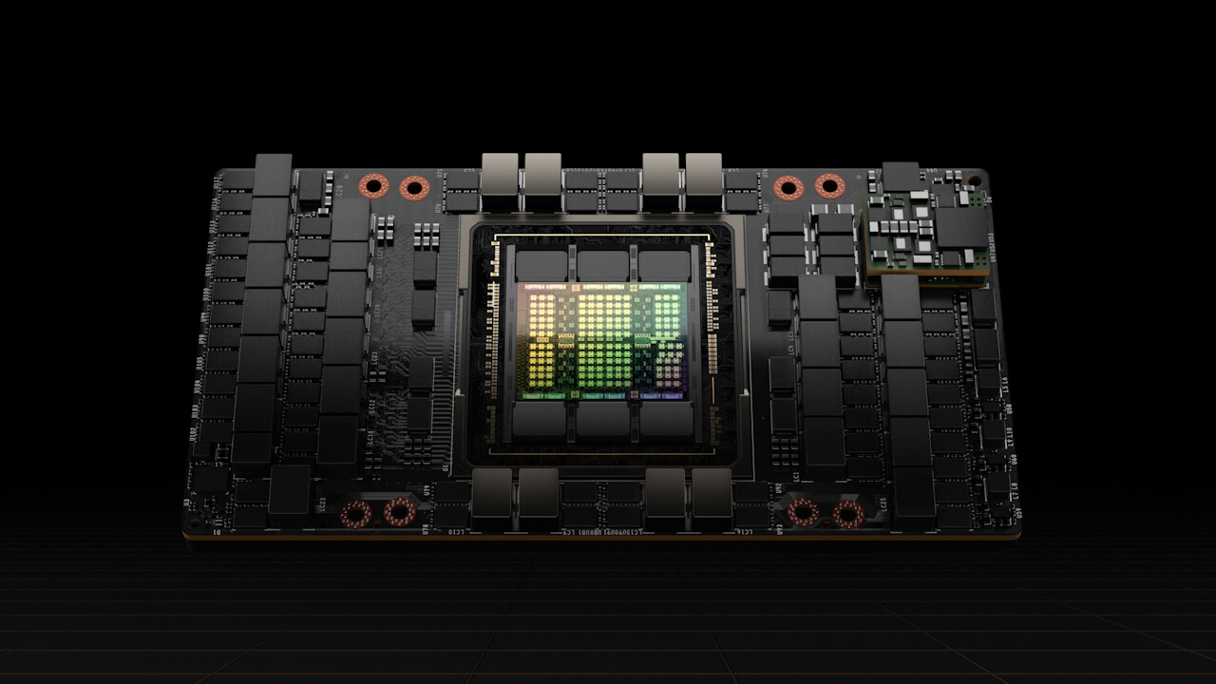
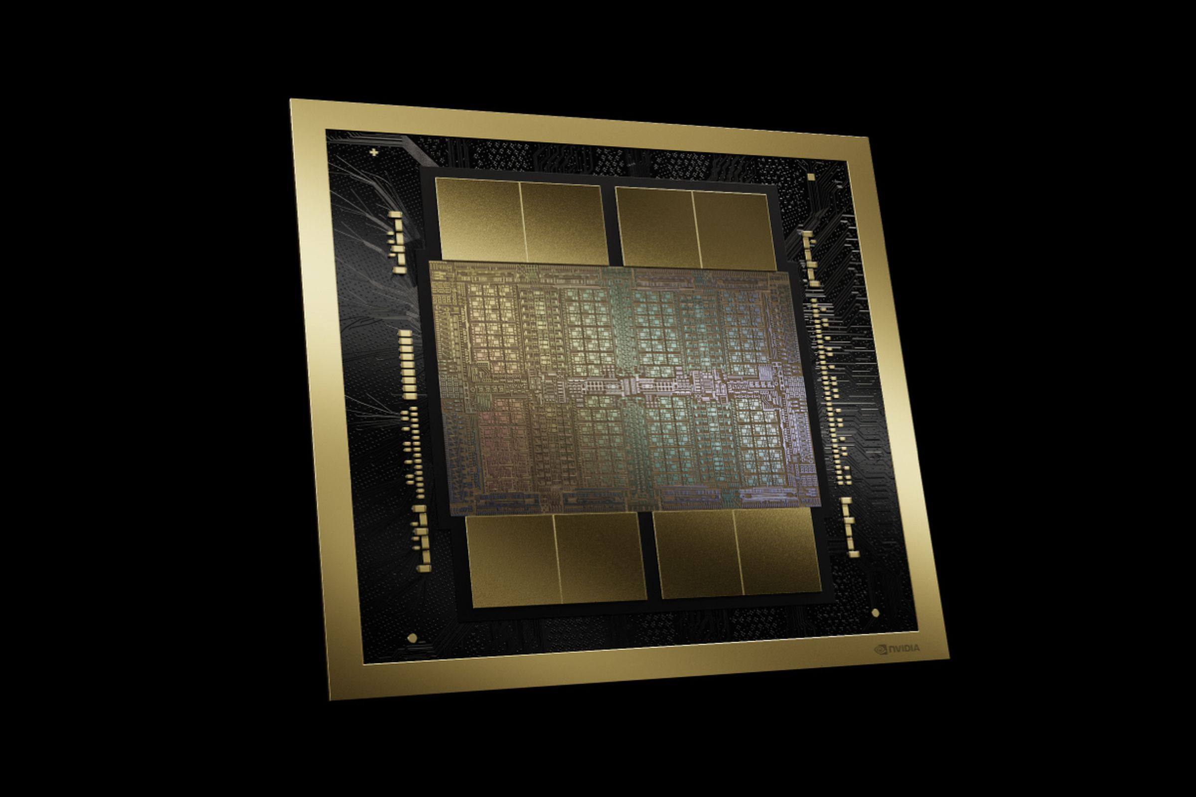
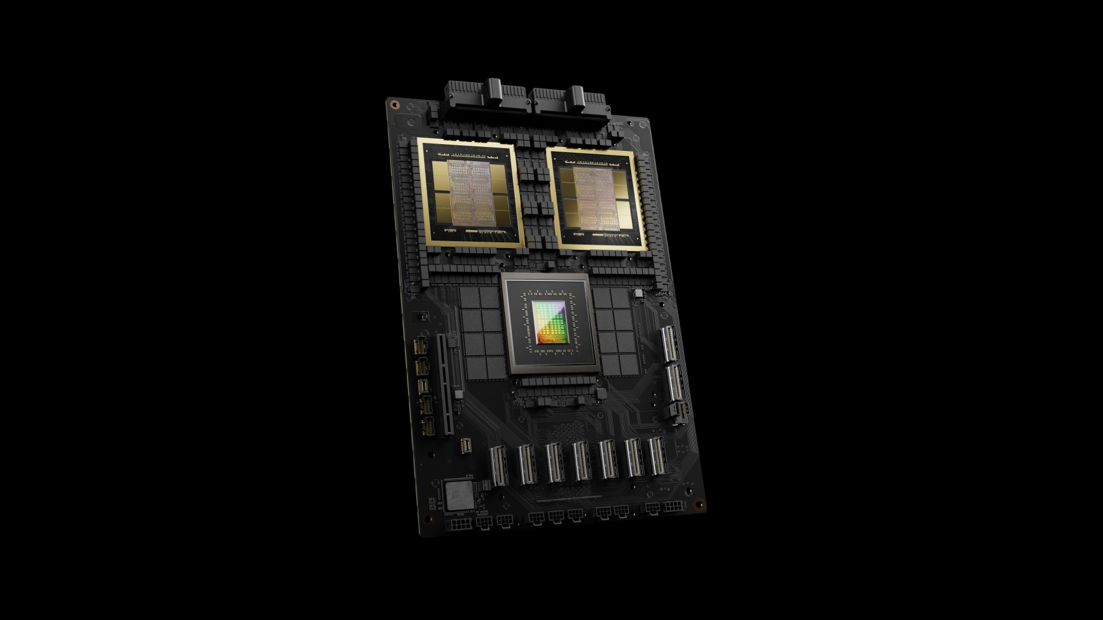
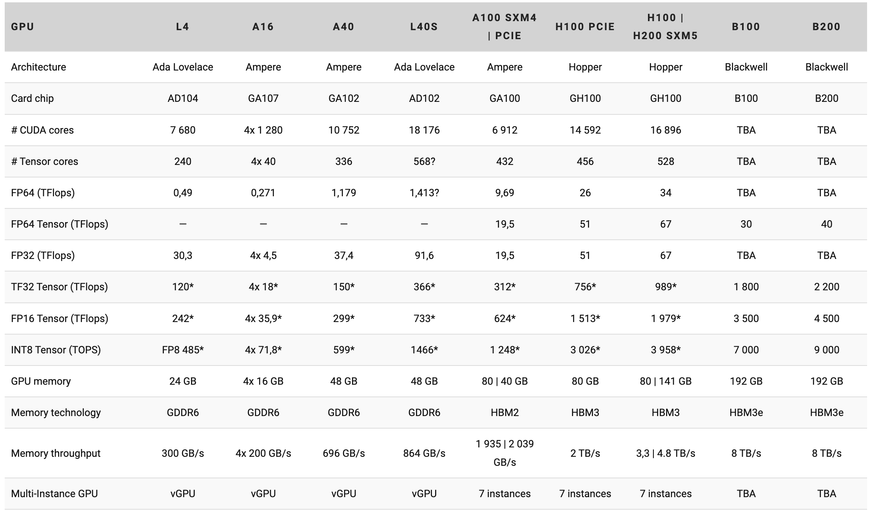
GPU Accelerators
GB200
Disk/SSD?
8
8

Slide 18
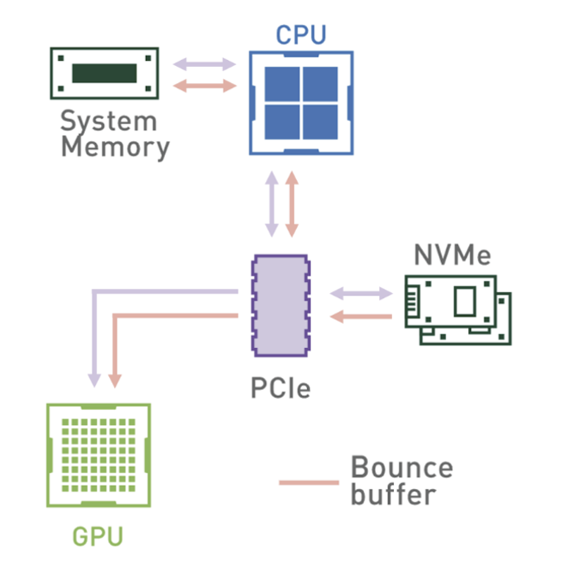
GPU Accelerator – as an add-on

Slide 19
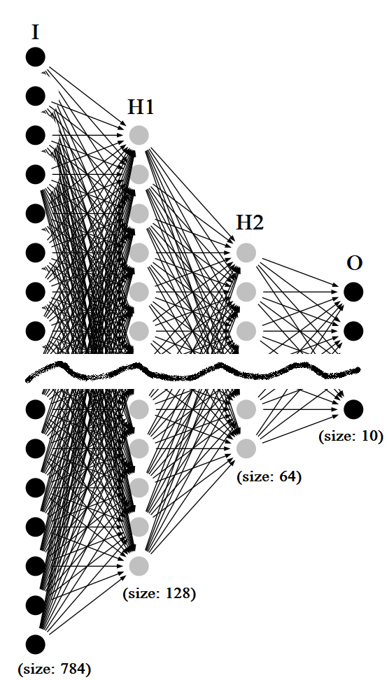
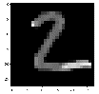
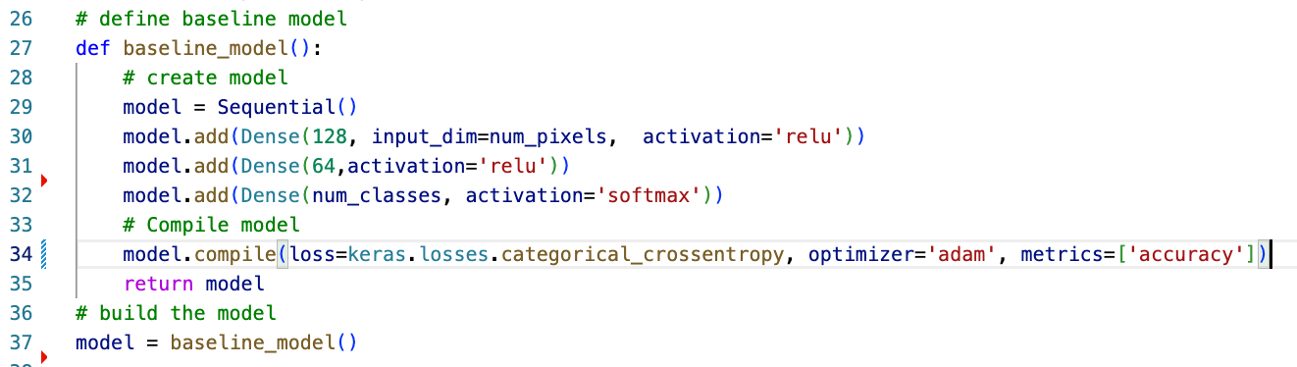
2
28x28 =784 px

Slide 20
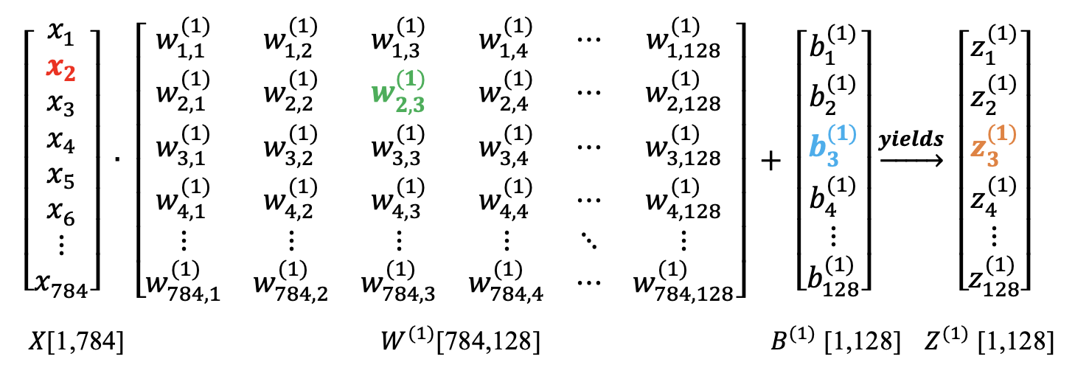
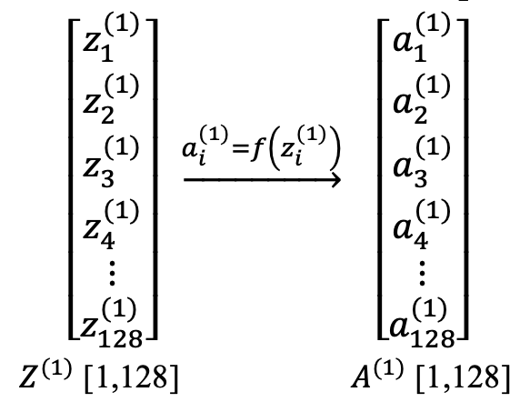
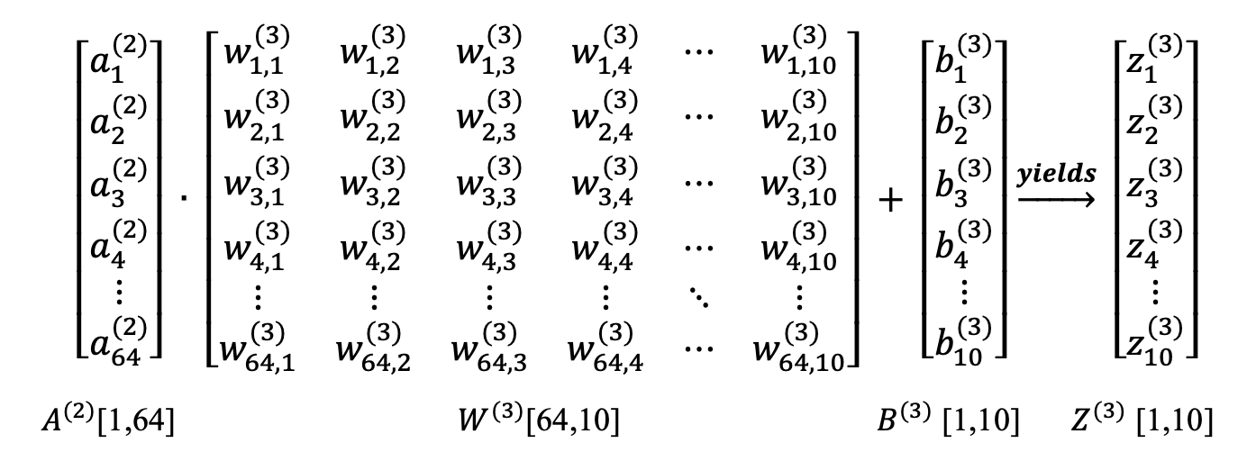
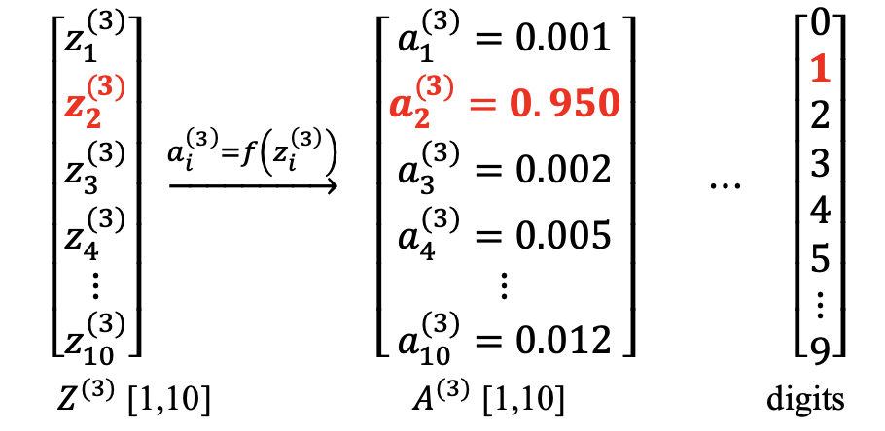
Feed Foward
$Z^{(1)} =$ $X∙W^{(1)}+B^{(1)}$
$$A^{\left(1\right)}=f \left(Z^{\left(1\right)}\right)$$
$Z^{(3)} =$ $A^{(2)}∙W^{(3)}+B^{(3)}$
$A^{(3)}=f (Z^{(3)})$
# w & b: 784 x 128 + 128 x 64 + 64x 10 + 128 + 64 + 10 = 109,386

Slide 21
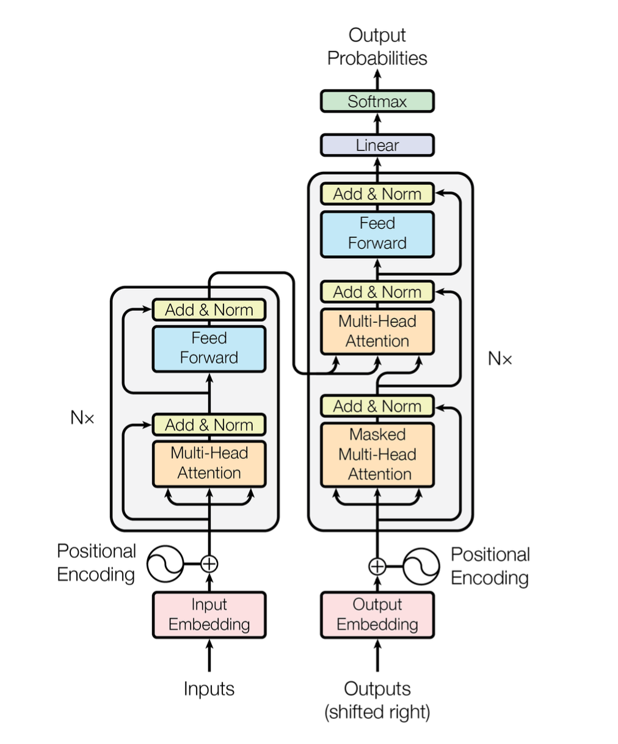
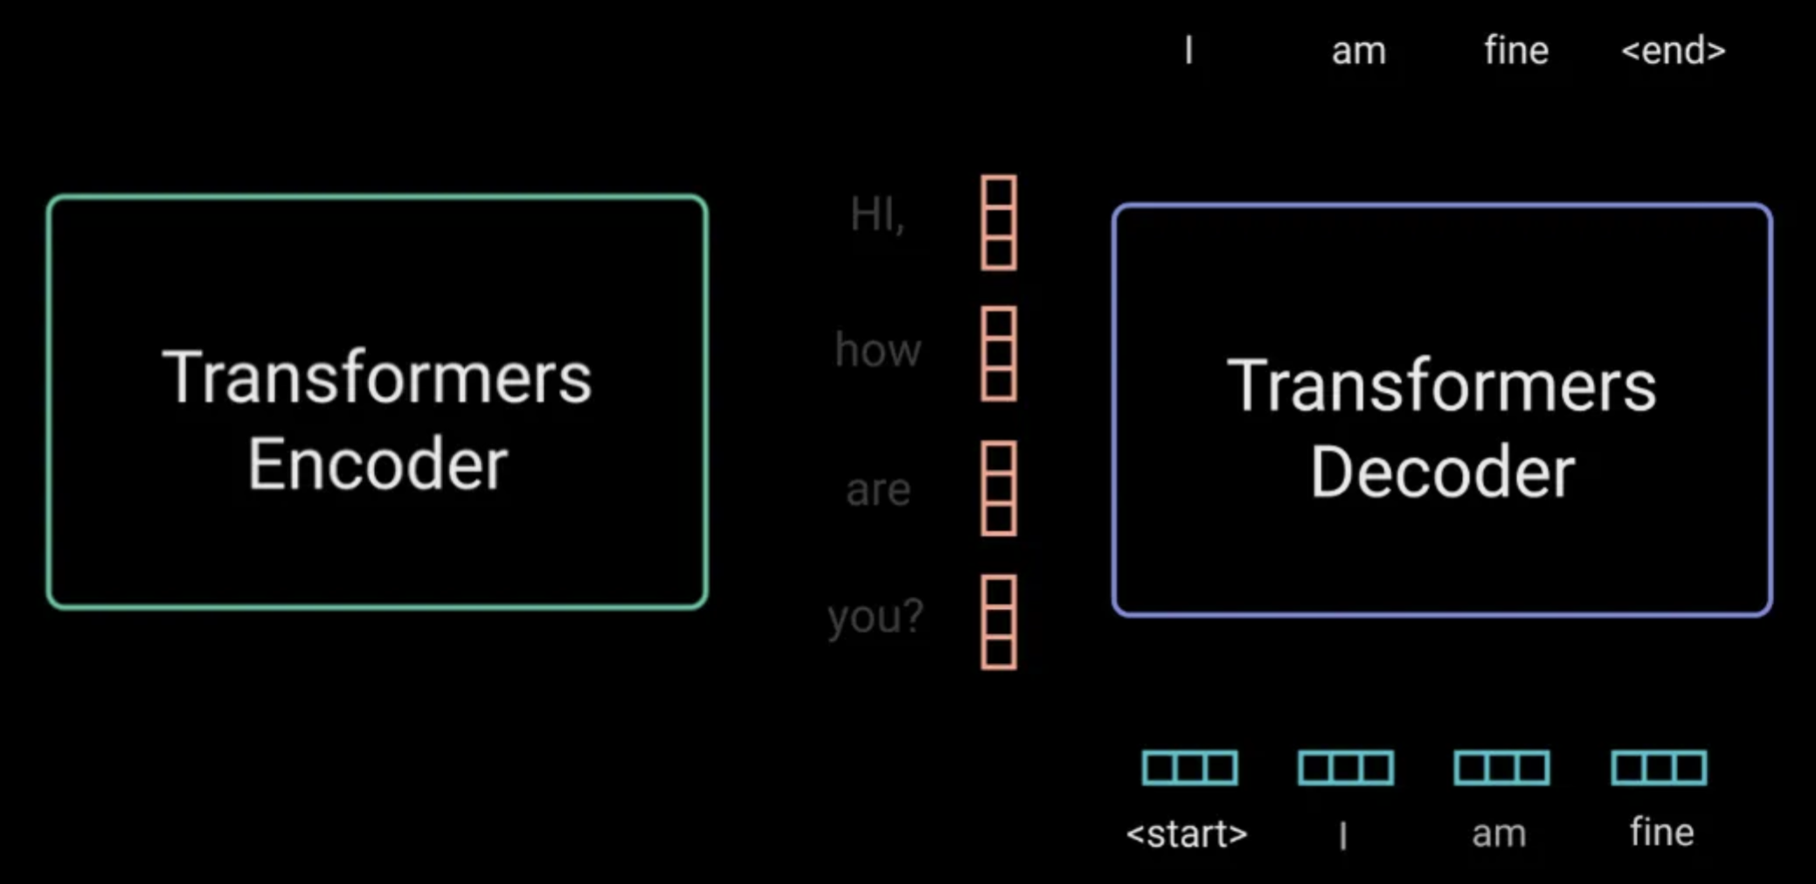

Transformer Architecture
# w & b:
llama2 13b
llama2 70b
gpt-3 175b
Encoder
Decoder

Slide 22



Training & Prediction
[
1.26511553e-11
3.34848538e-11
2.27058594e-09
7.83632743e-07
1.64589414e-12
1.47751115e-13
2.11127085e-19
9.99999166e-01
1.92158459e-11
1.27989965e-08
]

Slide 23


DGX B200 vs DGX H100:
3X in training
15X in inference
Complete DC infra

Slide 24


77 X
# w & b
55 X
B200 is about 7 X of H100 in inference, which makes it about 77 X of A100
B200
2024

Slide 25

GPUDirect Storage (GDS)
With computation shifting from the CPU to faster GPUs for AI, ML and HPC applications, IO into and out of the GPU can become the primary bottleneck to the overall application performance.
NVIDIA created Magnum IO GPUDirect Storage (GDS) to streamline data movement between storage and GPU memory and remove performance bottlenecks in the platform, like being forced to store and forward data through a buffer in CPU memory.
PCIe4: 2 GB/s/lane
PCIe5: 3.94 GB/s/lane, 16 lane -> 63 GB/s

Slide 26



GPU DRAM
Source: storage and gpu performance .., 2021, nvidia

Slide 27



Ecosystem
GPU
HBM
SSD
B200:
INT8 9000 TOPS
FP32 2200 TFLOPs
CUDA Cores: multiples of 16K
Tensor cores: A lot
HBM3e:
8 TB/s
Memory Bus:
2x 4096 Bit

Slide 28


SSD vs Computational Storage
Kingston SSD 8020 QD2-16
Source: ScaleFlux article
Kingstone QD16: 1.4 mil IOPS
PNY XLR8 CS3140:
sRead - 7.7GB sWrite – 6.0 GB
CSD 5000 (ASIC): 3.3 mil IOPS
sRead: 14GB/s sWrite: 11GB/s

Slide 29

SSD vs Computational Storage

Slide 30


moves computing tasks from the CPU to a device closer to storage: Compression/Filtering/Crypto/indexing/searching/ai task
improves application performance, infrastructure efficiency, and security and privacy.
reduces latency, bandwidth usage, and energy requirements because there's less need to transmit data
ScaleFlux VNext CSD* using
Arm® Cortex®-R82,
64-bit Armv8-R AArch64
Established players: Intel, IBM, Microsoft, Nvidia, Samsung, Arm, NetApp
Emerging players: ScaleFlux, Pliops, AMD

Slide 31
TAM (2024-2030)
The market for computational storage is expected to see significant growth in the next six years, driven by several key trends:
Increasing Data Volume and Processing Needs
Rise of Cloud Computing and IoT
Focus on Efficiency and Cost Reduction
TAM (Total Addressable Market) Projections
Next Move Strategy Consulting estimates the market size at USD 6.5 billion in 2023, reaching USD 17.82 billion by 2030, with a CAGR of 15.5%
Key Considerations
While the outlook is positive, some factors could impact the growth of computational storage:
Maturity of Technology: Computational storage is a relatively new technology, and it may take some time for it to mature and become widely adopted.
Standardization: The lack of industry standards for computational storage interfaces and protocols could hinder adoption.
Cost and Complexity: Implementing computational storage solutions can be more complex and expensive than traditional storage solutions.

Slide 32
ScaleFlux
What functions are their products best at?
How much do data centers need to customize their SSD or stack to use ScaleFlux’s SFX and CSD tech?
Are they certified by Nvidia GPU DirectStorage?
Objective benchmark data on R/W performance
Customer feedbacks

Slide 33
Finally, the “hard” talk is over.
Thanks!

Slide 34
References:
https://mcomputers.cz/en/products-and-services/nvidia/accelerators/
https://resources.nvidia.com/
https://www.tutorialspoint.com/cuda/cuda_introduction_to_the_gpu.htm
https://www.kingston.com/en/blog/servers-and-data-centers/5-reasons-for-using-enterprise-ssd
https://blocksandfiles.com/2024/03/13/scaleflux-make-go-faster-computational-storage-soc/
https://developer.nvidia.com/blog/accelerating-io-in-the-modern-data-center-magnum-io-storage-partnerships/
https://www.jotrin.com/technology/details/storage-and-gpu-performance-have-both-grown-exponentially
https://www.techtarget.com/searchstorage/definition/computational-storage

